Slide 1

SNAKE GAME IN C
Rohan das – soham maitra – saheli sau – rounak ganguly

Slide 2

Abstract
For this project, we chose to create a Snake Game which we used to play in old mobiles.
The purpose of the project was to gather knowledge about different header files in C Language, their different functions and how to use them.
Using standard functions we were able to develop and implement most of the features, though it is not exactly perfect. We’ll discuss the drawbacks of the application in this report itself.

Slide 3
Functions required for making the Game
First lets discuss about the kbhit() function, the full name of the function is keyboard hit. It is present in conio.h header file and used to determine if a key has been pressed or not. If a key has been pressed it returns a non-zero value otherwise it returns 0.
Now lets discuss about the rand() function. The name clearly suggests that it is used to generate random numbers in the range [0, RAND_MAX). rand()%100 -> It generates a Random Number between 0 to 99
system(“cls”) -> It clears the Console Screen.
We’ll discuss about some functions which are not generally used in programming, they are:
kbhit()
rand()
system(“cls”)

Slide 4
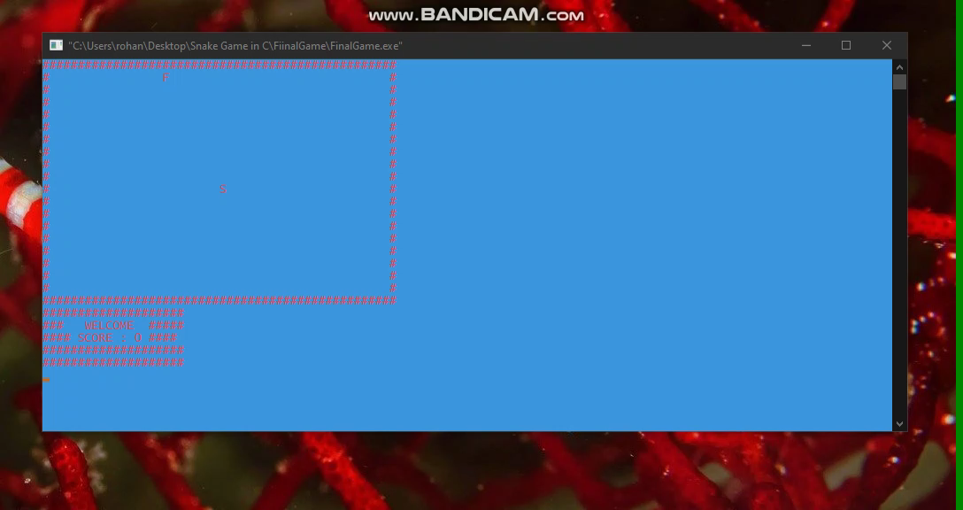
Here is the Game
Here is a video o the gameplay.

Slide 5
Difficulties Faced and Conclusion
The main problem of making the game is that we faced the blinking of the console screen. Though we try to overcome it with the for loop nested in a for loop in main function, it’s not very efficient. We also used delay function instead of that, but its same as before.
It was an exciting project to work on and there is a lot I learnt from it, above and beyond its original scope. I was able to study and train myself on development in an environment that was almost completely foreign to me, which I believe I have been reasonably successful with.
To get the full project code visit: Rohan's Git Profile

Slide 6
Acknowledgement
We would like to express our special thanks of gratitude to my teacher Moumita Ma'am as well as our principal Swagatam Sir who gave us the golden opportunity to do this wonderful project on the topic, which also helped us in doing a lot of research and we came to know about so many new things we are really thankful to them.

Slide 7
Members of this Project
Rohan Das
Author
Roll – 14
Email
Soham Maitra
Co-Author
Roll – 95
Email
Rounak Ganguly
Co-Author
Roll – 1
Email
Saheli Sau
Co-Author
Roll – 96
Email

